Slide 1

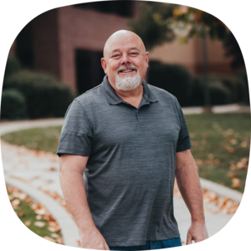

Seminar Offered by:
Presenter:
Mike Klockenbrink

Slide 2
WHAT IS AB-506?
Because of the numerous cases of sexual abuse tragedies (Boy Scouts), on September 16, 2021, the State of California passed AB 506. Prior to this bill, churches were responsible for determining their own abuse prevention. There were no laws outlining specifics in the areas of background checks, training, or policies.

Slide 3
DOES THIS NEW LAW APPLY TO ME?
The new California legislation (AB-506) requires employees, administrators, and volunteers of youth-serving organizations (including houses of worship, schools, daycares, and nonprofits) to complete training in child abuse & neglect reporting and undergo Live Scan background checks.

Slide 4
WHAT DEFINES A VOLUNTEER
AB 506 specifically defines ‘Regular Volunteers’ as ‘a volunteer with the youth service organization who is 18 years of age or older and who has direct contact with, or supervision of, children for more than 16 hours per month or 32 hours per year.’

Slide 5
WHEN DOES THIS NEED TO BE COMPLETED?
The law was passed on September 16, 2021, and is effective, on January 1, 2022.
Start taking steps to get this completed before the year’s end.
  Paid employees are a priority; this is not an option.
  Volunteers by groups: children’s, middle school & high school.
What about new employees or volunteers?
  Within the first 90 days of them being hired or serving.

Slide 6
WHAT TRAINING IS REQUIRED?
Mandated Reporter Training
https://www.mandatedreporterca.com
  General – 4 hours
    https://www.mandatedreporterca.com/training/general-training
  Clergy – 2 hours
    https://www.mandatedreporterca.com/training/clergy
  Volunteer – 2 hours
    https://www.mandatedreporterca.com/training/volunteers
This training must be done every two years.

Slide 7
WHAT WILL I LEARN
How the law defines child abuse and neglect?
  Think about elder abuse also
What the law requires of a mandated reporter?
What protections the law provides for a mandated reporter?
How to spot evidence of child abuse.
How to report child abuse.
What happens after a report is filed?

Slide 8
RECORD KEEPING
Does the state keep records for those who have taken the training?
  NO
You need to keep your own records.
  Individuals should provide you with a completed certificate
  Create an Excel spreadsheet
  In your church software database (make this a requirement)
    PCO (Planning Center Online) People module is free
  Third-party companies such as Ministry Safe
This training must be done every two years.

Slide 9
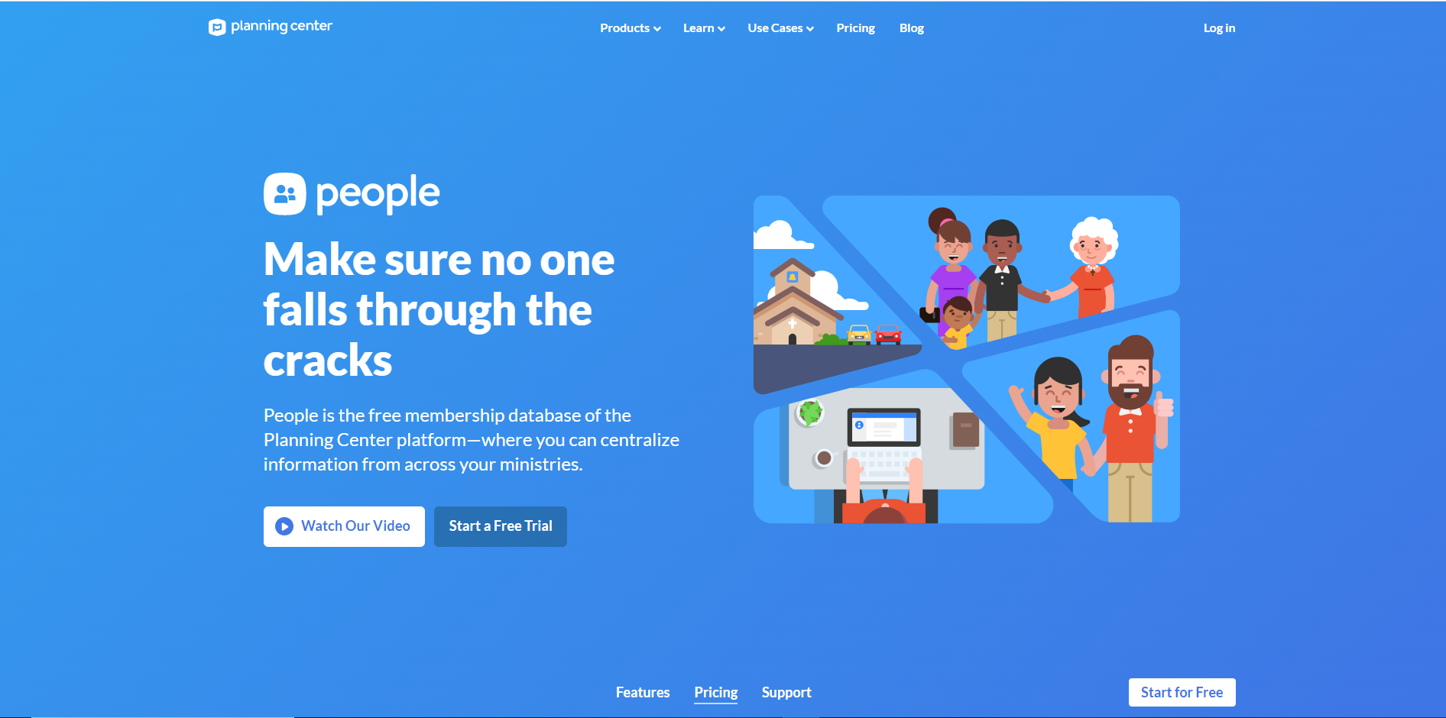

Slide 10
LIVE SCAN
Which employees need a LIVESCAN background check?
The law specifies that ALL employees need a Live Scan Background Check, not just those that work with youth. Yes, this means those that never have any contact with youth, musicians, part-time, seasonal, occasional, and any other employees.
What about Volunteers
(AB-506) requires employees, administrators, and volunteers of youth-serving organizations (including houses of worship, schools, daycares, and nonprofits) to complete training in child abuse & neglect reporting and undergo Live Scan background checks.
When does this need to be completed?
If you are not already doing Live Scan at your church, you need to apply to become a custodian of records with the DOJ. (Department of Justice) This needs to be done by years end.

Slide 11
HOW DO I GET STARTED WITH LIVE SCAN?
Visit the following site to apply to become a Custodian of Records.
https://oag.ca.gov/sites/all/files/agweb/pdfs/fingerprints/custodian/bcia-8374.pdf
How much does this cost?
  The average cost in Sacramento County runs around $25.00
  Remember, this is a one-time cost.
Who pays for this?
  This is up to you.
    Lakeside currently pays for all employees.
    Lakeside volunteers pay for themselves.
      If you have ever volunteered to serve at a school or kids’ sports, you pay.
What if I’ve already been Live Scanned somewhere else?
  Live Scan cannot be shared between different organizations.

Slide 12
What is the penalty if we don’t comply with the new requirements?
The law allows insurance carriers to seek verification of compliance with these requirements. Insurance companies will check that you are meeting the requirements of AB 506. The primary enforcement will be through legal action. Should your ministry ever have an allegation of abuse, the first questions that will be asked by the plaintiff’s attorneys will be if you met the requirements of AB 506. This will introduce punitive damages (not covered by any insurance company) and opens your leadership to personal liability for disregarding the law.

Slide 13
Questions and maybe answers?

